Slide 1
Single Layer Percetron
091601
  by Huafu Chen
SLST
UESTC, China

Slide 2
3.1Introduction
In the formative years of Neural Networks (1943-1958), several researchers stand out for their pioneering contributions:
McCulloch and Pitts (1943) for introducing the idea of neural networks as computing machines.
2) Hebb (1949) for postulating the first rule for self-organized learning

Slide 3
3) Rosenblatt (1958) for proposing the perceptron as the first model for learning with a teacher (i.e. supervised learning).
Perceptron: It is the simplest form of NN for classification of linearly separable patterns, i.e., patterns that lie on opposite sides of a hyper-plane.
It consists of a single neuron with adjustable synaptic weights and bias.

Slide 4
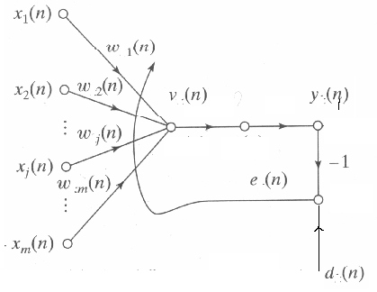
3.2 Adaptive filtering problem

Slide 5
3.3 Unconstrained optimization techniques
General
Cost functions E(w)
Optimize E(w*)<=E(w) (3.5)
Optimality
∇E(w*)=0 (3.7)
(local minimum, global minimum)
Local iterative descent:
E(w(n+1))<E(w(n)) (3.10)
(implicitly: single linear neuron, m inputs, dimension of w is m, i=1,…, n samples in the following discussion)

Slide 6
3.3 Unconstrained optimization techniques
How to calculate and utilize ∇E(w) ? Steepest Descent (first-order gradient)
Definition: The successive adjustments of w are in the direction of steepest descent- opposite to the gradient vector ∇E(w)=g (notation). (3.11)
w(n+1)=w(n)- ηg (3.12)

Slide 7
3.3 Unconstrained optimization techniques
Steepest Descent (first-order gradient)
Illustration:
1) From (3.12)→ Δw= - ηg (3.13)
2) First-order Taylor series expansion of E(w(n+1)) around E(w(n))
E (w(n+1))=E(w(n))+g^{T}(n) Δw, with (3.13)
= E(w(n))- ηg^{T}(n)g= E(w(n))- η||g||²
3) E (w(n+1))<= E(w(n)) (3.10)

Slide 8
3.3 Unconstrained optimization techniques
4) Discussion:page 123
I) converges slowly (first order gradient);
2) η influence
small: overdamped
large: underdamped
exceeds a critical value:
Unstable (diverges))
(gradient is a local property) )

Slide 9
3.3 Unconstrained optimization techniques
Newton’s Method (second order derivatives)
1) Taylor series expansion of E(w(n+1)) around E(w(n)) to second order
ΔE (w(n)) {=E(w(n+1)-E(w(n))}
= g^{T}(n) Δw(n)+1/2 Δw^{T}(n)H(n)Δw(n)+… (3.14)
H- Hessian Matrix (page 124)
2) maxi(mini)mization ΔE by set derivative of ΔE with respect to Δw:
g(n)+H(n) Δw(n)=0
3) w(n+1)=w(n)-H⁻(n)g(n)
4) Converge quickly (two order); require H being positive definite; ( derivative max/minimum—local; initial values)
Notes:
10-00
Derivative被引出的，延伸的，派生的

Slide 10
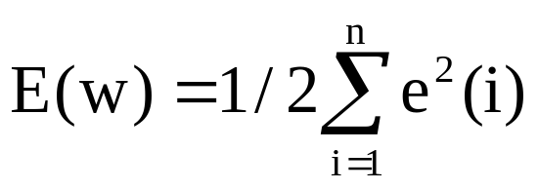
3.3 Unconstrained optimization techniques
Gauss-Newton Method
-- above, no concrete form of the cost function
-- for cost function expressed as the sum of error squares.
(3.17)
Gauss: pioneer of the least squares (error squares) fit
½ for subsequent convenience; All the error terms are calculated on the basis of a w that is fixed over the entire observation interval n ≥i ≥1.

Slide 11
Gauss-Newton Method
1) Taylor expansion of e(i) as function of w
e’(i,w)=e(i)+F (w-w(n))+…, i=1,…,n. ( keep first-order)
F-- the derivative of e(i) with respect to w.
e’(n,w) =e(n) +J(n)(w-w(n)) (3.19)
e(n)=[e(1),…,e(n) ]^{T}, J(n) (n-by-m)-Jacobian matrix.
2) The updated w(n+1) is defined by
w(n+1)=arg min_{w}{1/2||e’(n,w)||² } (3.21)
→ Insert (3.19) into (3.17)：
1/2||e’(n,w)||² = 1/2||e(n)||² + e ^{T}(n)J (n)(w-w(n))+ ½(w-w(n))^{T}J^{T} (n)J(n)(w-w(n))
Notes:
10-00
这里对e(I)的展开保留 一阶，但因cost function 是 e(I)的二次函数，因此，总体还是 Newton的二阶。
m the dimension of the vector W ( the dimension of input vector x)
n the the samples
The derivation of eq 3.22 see page 125

Slide 12
1/2||e’(n,w)||² = 1/2||e(n)||² + e ^{T}(n)J (n)(w-w(n))+ ½(w-w(n))^{T}J^{T} (n)J(n)(w-w(n))
Gauss-Newton Method
Differentiating the above 1/2||e’(n,w)||² with respect to Δw and setting the result equal to zero.
→ w(n+1)=w(n)-(J^{T} (n)J(n))⁻¹J^{T} (n)e(n) (3.22)
Notation: according to(3.19)
e’(n,w) =e(n) +J(n)(w-w(n))
Ideally, if we let the left equal zero, we have
-e(n) =J(n)(w-w(n))
By Generalized inverse, suppose J(n) is of full row rank, we have
w(n+1)=-J^{T(+)} (n)e(n)--- the same as (3.22)
(!! generalized inverse are theoretically related with Gauss LS algorithm)
Notes:
10-00
这里对e(I)的展开保留 一阶，但因cost function 是 e(I)的二次函数，因此，总体还是 Newton的二阶。
m the dimension of the vector W ( the dimension of input vector x)
n the the samples
The derivation of eq 3.22 see page 125

Slide 13
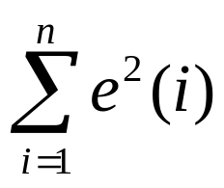
Gauss-Newton Method
(J^{T} (n)J(n)) must be nonsingular. It requires that J(n) must have row rank n. However,there is no guarantee that this condition will always hold.
1) Modified the cost function
E(w)=1/2{δ||w-w(n) ||² +
2) The result
w(n+1)=w(n)-(J^{T} (n)J(n)+ δ I)⁻¹J^{T} (n)e(n)
(regularization)
Notation: If δ tends to infinity, w(n+1) tends to w(n), no changes will occur. So, from the cost function to the result, we hope the change is smooth/gentle, no surprise/great change/singular, so the process is stable. Thus REGULARIZATION!!
Notes:
10-00
Discussion：w 固定，但n次输入的x不同，e(i)相应不同，即位于e(w,x(i))曲面的不同点，因此e(i)对w的导数因隐含的x(i)的不同而不同。
J(n) - row rank –n, means the n samples are independent

Slide 14
3.4 Linear least-squares filter 线性最小二乘滤波
Above (Gauss-Newton), the cost function is a sum of error squares, here further concrete the error itself ( linear with the variables):
For a linear neuron
1) e(n) =d(n)-X(n)w(n) (3.25)
( n, n, n-by-m m :dimensions)
2) ∇e(n)= -X^{T}(n) → J(n)= -X(n) (3.26) (similar to (3.19))
3) Substituting Eqs.(3.25), (3.26) in (3.22) yields
{ w(n+1)=w(n)-(J^{T} (n)J(n))⁻¹J^{T} (n)e(n) (3.22) }
w(n+1)=(X^{T} (n)X(n))⁻¹ X^{T} (n)d(n)
=X⁺ (n) d(n) (3.29)
（ The forward problem: d(n) = X(n)w(n) )
4) Conclusion:
The weight vector w(n+1) solves the linear least-squares problems defined over an “observation interval of duration n”.
Notes:
10-00
在上面 的方法中 没有告诉 我们 J(n)怎么求
（3.29）这就是 最小二乘法的结果 of d=WX +e
Where X(n) is the n by m data matrix
d(n) is n by 1
e(n) is also n by 1 (each sample vector (small x (i ) ) is m by 1)
Thus X (x(1) x(2) … x(n) )T (upper) is n by m
J is a n by m Jacobian matrix

Slide 15
3.4 Linear least-squares filter
线性最小二乘滤波器
Wiener filter:
When x(i) and d(i) are from an ergodic (各态遍历） environment that is also stationary.
w_{o}=lim_{n→∞}w(n+1)= lim_{n→∞}{(X^{T} (n)X(n))⁻¹ X^{T} (n)d(n)}
= {(lim_{n→∞}1/nX^{T} (n)X(n)}⁻¹ lim_{n→∞}(1/nX^{T} (n)d(n))
=R_{x}⁻¹ r_{xd}
For an ergodic process, the linear least-squares filter asymptotically approaches the Wiener filter as the number of obsearvations approaches infinity.
Notes:
10-00
样本 充分大 时，样本遍历了所有的情况，因此，样本也是具有绝对的代表性，结果就是最优的
Correlation matrix Rx, the cross-correlation vector rxd.

Slide 16
3) Wiener filter is based on the second-order statistics:
Correlation matrix, the cross-correlation vector.
These informations are not available in many important situations encountered in practice.
4) We may deal with an unknown environment by using a linear adaptive filter, the filter adjusts its free parameters in response to statistical variations in the environment.
5) A high-popular algorithm for doing this kind of adjustment on a continuous basis is the least-mean-square(LMS) algorithm, which is intimately related to the Wiener filter.
Notes:
10-00
最小二乘滤波器

Slide 17
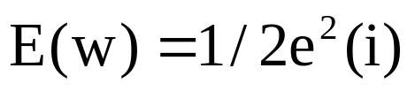
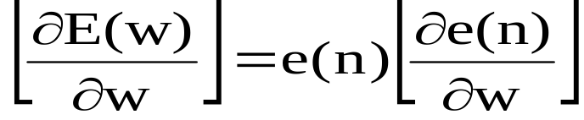
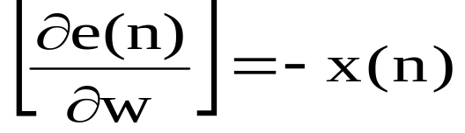
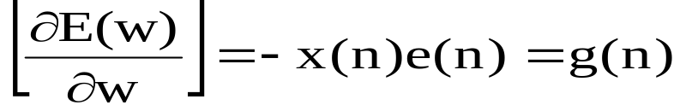
3.5 Least-Mean-Square algorithm
最小均方算法
1) The LMS algorithm is based on the use of instantaneous values for the cost function,
2)
3) e(n) =d(n)-x^{T}(n)w(n) (similar to (3.25) for one moment):
and
4) w(n+1)=w(n)+ ηx(n)e(n) (similar to (3.12)) for the method of steepest descent)
Widrow and Hoff algorithm (Error-correction learning)
Notes:
10-00
最小均方算法
1) Least squares (LS gauss method) using data up to the iteration n,
2) Least mean square (LMS) algorithm using instantaneous values of the cost function
LS 类似批处理
LMS 类似 逐点处理

Slide 18
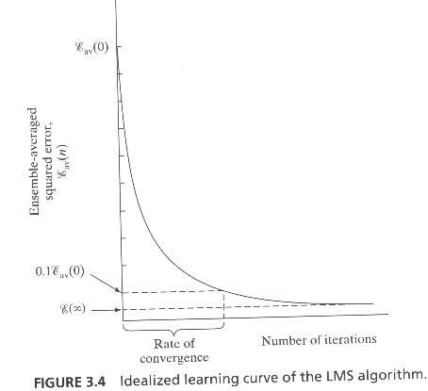
Summary of LMS algorithm
Training sample: input signal vector x(n)
desired (scalar) response d(n)
User selected parameter η >0
Initialization set ŵ(1) = 0
Computation for n = 1, 2, … compute
e(n) = d(n) - ŵ^{T}(n)x(n)
ŵ(n+1) = ŵ(n) + η x(n)e(n)
Notes:
10-00
Sequential processing style

Slide 19
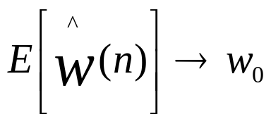

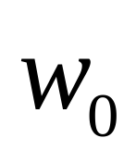
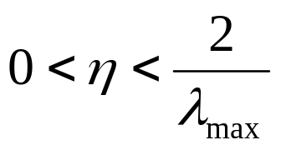
3.5Convergence consideration of LMS
LMS alogorithm convergence
Is the wiener solution
Haykin(1966) show the LMS convergent condition :

Slide 20
3.6Learning curves
An informative way of examining the convergence behavior of LMS algorithm or a adaptive filter in general
The Learning cure is a plot of the mean-squre value of the estimation error,εav(n), versus the number of iteration, n

Slide 21
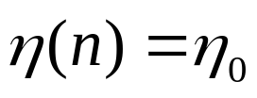
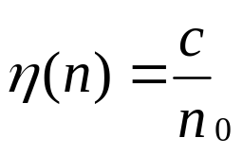
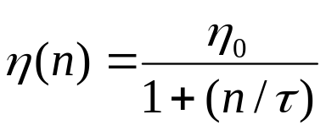
3.7Learning annealing schedules
The difficulties encountered with LMS Learning rate is maintained constant
Stochastic approximation Time-varying(Robbins etc 1951)
(Search-then- convergen schedule Alternative (Darken etc 1992)

Slide 22

Perceptron: Architecture
We consider the architecture: feed-forward NN with one layer
A single layer perceptron with just one neuron:
Notes:
10-00

Slide 23
Perceptron: Neuron Model
Uses a non-linear (McCulloch-Pitts) model of neuron:
b (bias)
x₁
w₁
v
y
x₂
w₂
ϕ(v)
w_{m}
x_{m}
ϕ is the sign function:
+1 IF v >= 0
ϕ(v) =
Is the function sign(v)
-1 IF v < 0

Slide 24
Perceptron: Applications
The perceptron is used for classification: classify correctly a set of examples into one of the two classes C₁, C₂:
If the output of the perceptron is +1 then the input is assigned to class C₁
If the output is -1 then the input is assigned to C₂

Slide 25
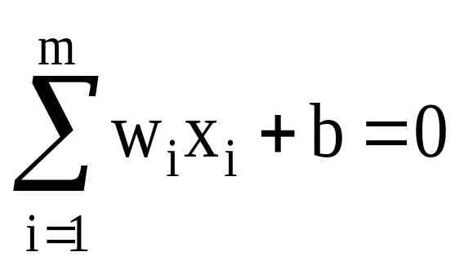
Perceptron: Classification
The equation below describes a hyperplane in the input space. This hyperplane is used to separate the two classes C1 and C2
decision
region for C1
x₂
w₁x₁ + w₂x₂ + b > 0
decision
boundary
C₁
decision
region for C₂
x₁
C₂
w₁x₁ + w₂x₂ + b <= 0
w₁x₁ + w₂x₂ + b = 0

Slide 26
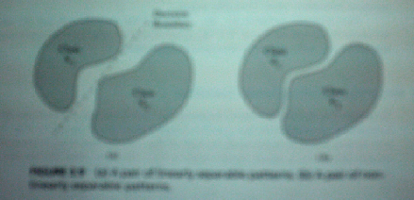
Perceptron: Limitations
The perceptron can only model linearly separable functions.
Left: linear separable; right: linear nonseparable.

Slide 27
Perceptron: Limitations
The perceptron can be used to model the following Boolean functions ( Example)
1) （与） AND ( x1Λx2)
Assume w1=1,w2=2, b=-2
v= φ(v)= 1*x1+2*x2-2 v>0 y=1, else y=0
Only x1=x2=1, y=1 (φ(v)=1) then v=1
x1=1; x2=0, y=-1 then v=0
x1=0; x2=1, y=0 then v=0
x1=x2=0, y=-3 then v=0

Slide 28
Perceptron: Limitations
2) OR （或) (x1 V x2)
w1=w2=1, b=-0.5
v=1*x1+1*x2-0.5
x1 or x2 =1, v>=0, y=1
3) COMPLEMENT（非）? X1
w1=-1,w2=0, b=0.9
v=(-1)*x1+0.9
x1 =1, v<0,y=0; x1=0, v>1,y=1

Slide 29
Perceptron: Limitations
4) XOR（异或）Problem ？？
XOR: x1x2Vx1x2
g（x，y）
y
0
1
x
0
0
1
1
1
0

Slide 30
Perceptron: Limitations
It requires v=w1x1+w2x2+b satisfy the following four equations for the two classes:
1） w1+w2+b<0(1 1), 0+0+b<0 ( 0 0) one class
2） W1+0+b>=0 (1 0), 0+w2+b>=0(0 1) another class
they are impossible to be satisfied at the same time
Perceptron cannot model the XOR（异或）
Notes:
10-00
Multi-layer pperceptron

Slide 31
Perceptron: Limitations
The XOR is not linear separable：
impossible to separate classes C₁ {（0，1），（1，0）} and C₂ {（0，0），（1，1）} with only one line
x₂
C₁
（1，1）
C₂
（0，1）
1
-1
1
C₁
-1
1
（1，0）
x₁
（0，0）
1

Slide 32
Perceptron: Learning Algorithm
Variables and parameters
x(n) = input vector
= [+1, x₁(n), x₂(n), …, x_{m}(n)]^{T}
w(n) = weight vector
= [b(n), w₁(n), w₂(n), …, w_{m}(n)]^{T}
b(n) = bias
y(n) = actual response （scalar)
d(n) = desired response (scalar)
η = learning rate parameter
Notes:
10-00
时刻 n 时 的 m 个分量

Slide 33
The fixed-increment learning algorithm
Initialization: set w(0) =0
Activation: activate perceptron by applying input example (vector x(n) and desired response d(n))
Compute actual response of perceptron:
y(n) = sgn[w^{T}(n)x(n)]
Adapt weight vector: if d(n) and y(n) are different then(LMS)
w(n + 1) = w(n) + η[d(n)-y(n)]x(n) (3.37)
+1 if x(n) ∈ C₁
Where d(n) =
-1 if x(n) ∈ C₂
Continuation: increment time step n by 1 and go to Activation step
Notes:
10-00
Error-correction learning

Slide 34
Example
Consider a training set C₁ ∪ C₂, where:
C₁ = {(1,1), (1, -1), (0, -1)} elements of class 1
C₂ = {(-1,-1), (-1,1), (0,1)} elements of class -1
Use the perceptron learning algorithm to classify these examples.
w(0) = [1, 0, 0]^{T} η = 1
Notes:
10-00

Slide 35
Example
x₂
1
-
-
+
Decision boundary:
2x₁ - x₂ = 0
(w1=2; w2=-1; b=0)
C₂
-1
1/2
1
x₁
-1
C₁
-
+
+

Slide 36
Convergence of the learning algorithm
Suppose datasets C₁, C₂ are linearly separable. The perceptron convergence algorithm converges after n₀ iterations, with n₀ ≤ n_{max} on training set C₁ ∪ C₂.
Proof:
  suppose x ∈ C₁ ⇒ output = 1 and x ∈ C₂ ⇒ output = -1.
  For simplicity assume (initialization) w(1) = 0, η = 1.
  Suppose perception incorrectly classifies x(1) … x(n) …∈ C₂.
  Then w^{T}(k) x(k) ≤ 0.
  (C1: d=1; (misclassification) y=sign(<0)=0; e=d-y=1)
  ⇒ Error correction rule (LMS(3:37):w(n+1)=w(n)+ ηex):
  w(2) = w(1) + x(1) w(3) = w(2) + x(2)
  ⇒ w(n+1) = x(1)+ …+ x(n)
  w(n+1) = w(n) + x(n).
Notes:
10-00
Here convergence means the algorithm will stop with a final constant weight factor W after no more nmax steps.

Slide 37
Convergence theorem (proof)
  Let w₀ be such that w₀^{T} x(n) > 0 ∀ x(n) ∈ C₁. w₀ exists because C₁ and C₂ are linearly separable.
  Let α = min{ w₀^{T} x(n) | x(n) ∈ C₁}.
  Then w₀^{T} w(n+1) = w₀^{T} x(1) + … + w₀^{T} x(n) ≥ nα
  Cauchy-Schwarz inequality: ||w₀||² ||w(n+1)||² ≥ [w₀^{T} w(n+1)]²
||w(n+1)||² ≥ (A)
n² α ²
||w₀|| ²

Slide 38
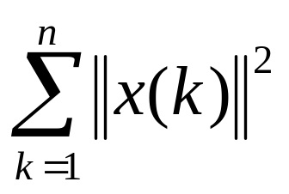
Convergence theorem (proof)
Now we consider another route: w(k+1) = w(k) + x(k) || w(k+1)||² = || w(k)||² + ||x(k)||² + 2 w ^{T}(k)x(k) euclidean norm  ≤ 0 because x(k) is misclassified
⇒ ||w(k+1)||² ≤ ||w(k)||² + ||x(k)||² k=1,..,n
=0 (initialization)
||w(2)||² ≤ ||w(1)||² + ||x(1)||²
||w(3)||² ≤ ||w(2)||² + ||x(2)||²
⇒ ||w(n+1)||² ≤
Notes:
10-00
WX may be larger than 0 and also may be smaller than 0
Here we need to remember w(0)=0

Slide 39
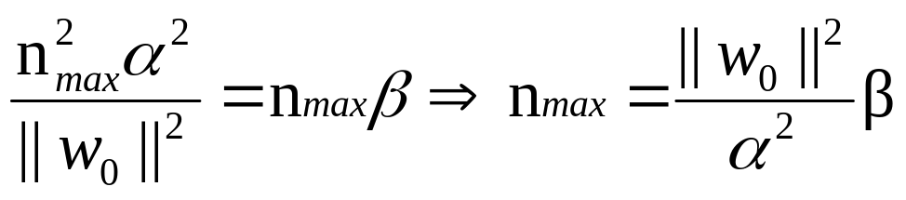
convergence theorem (proof)
Let β = max ||x(n)||² x(n) ∈ C₁
||w(n+1)||² ≤ n β (B)
For sufficiently large values of n: (B) becomes in conflict with (A). Then n cannot be greater than n_{max} such that (A) and (B) are both satisfied with the equality sign.
Perceptron convergence algorithm terminates at most n_{max}= iterations.
β ||w₀||²
α²

Slide 40
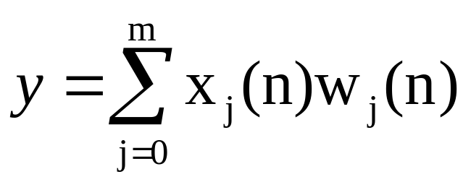
Adaline( Adaptive Linear Element)
The output y is a linear combination of x
x₁
w₁
y
x₂
w₂
w_{m}
x_{m}
Notes:
10-00
自适应线性分类单元
这里 activation function 没有用前面那个符号函数

Slide 41
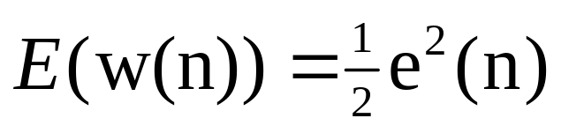
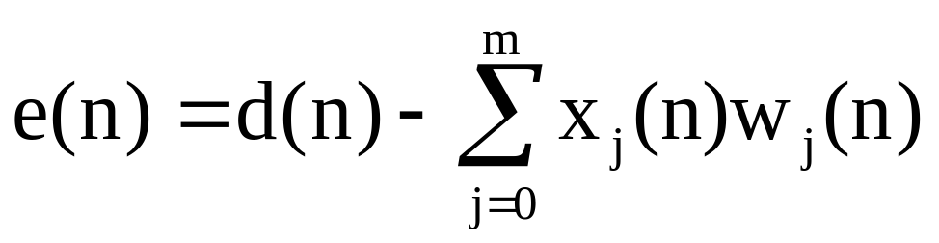
Adaline: Adaptive Linear Element
Adaline: uses a linear neuron model and the Least-Mean-Square (LMS) learning algorithm
  The idea: try to minimize the square error, which is a function of the weights
We can find the minimum of the error function E by means of the Steepest descent method

